Slide 1
Telling Your Story
Using Data to Communicate Needs
Notes:
Have this slide up when participants enter.
The emphasis for this session will be on using publically accessible data to help define the local need, the first step in telling an effective story.
Time: 1 minute
Total session: 90 minutes

Slide 2
Session Overview
What data can tell us
Digging in
I like your story
Notes:
This session has three parts:
An overview of publically available data to help define the community need relative to this USDA Ag & Rural Prosperity priority.
Time to examine the data for your community (or using the handout) to think about how you would describe the need at home.
A little friendly competition to select a great story to share with the large group
Time: 2 minutes

Slide 3
Types of Data to Help Tell Your Story
Digital Distress
Farm Internet Use
Worker Productivity
Maximum Advertised Internet Speeds
Digital Divide Index
Notes:
For this priority (insert the one discussed), we will be looking at these types of data. [Read from the slide for specifics related to this priority].
We will be looking at examples from one rural county in Kentucky (Bourbon County) just to provide a common context for the data.
Time: 1 minute

Slide 4
Measures of Digital Distress
High percent of homes not subscribing to the internet or subscribing only through a cellular plan
High percent of homes with no computing devices or relying on mobile devices
Source: American Community Survey 2012-2017 (available at the census tract level), Table S2801; Website: http://factfinder.census.gov
Notes:
The American Community Survey now provides insights into digital distress. Key points are highlighted on this slide. The next slide gives an example from our sample county.
Time: 1 minute

Slide 5
Digital Distress – Bourbon Co, KY
Internet
Access
Computer
Access
Internet only through cell
Only through cell
No computing device
No Internet
6.3%
34.6%
10.9%
19.7%
Notes:
This slide depicts where Bourbon County, KY stands on these key indicators.
Note that over 1/3 of the population has no Internet access and almost 1/5 do not have computing devices at home.
This is important because it limits:
Youth trying to work on homework
Adults seeking jobs
Adult education opportunities
Access to online services such as healthcare, banking, retail, and online benefits
Social connections with friends and family living in distant places
Time: 5 minutes

Slide 6
Worker Productivity 2015
Goods producing includes:
Agriculture
Forestry
Mining
Construction
Manufacturing
Gross Domestic Product (GDP) output and number of personnel data available at: https://www.bea.gov/data/gdp/gdp-county
Notes:
This is a slide that measures worker productivity. This is important for e-connectivity because it is hypothesized that worker productivity is greatly hampered when there is limited or no access to the internet.
One measure of productivity or efficiency is the value of goods or services sold per worker. This is often measured as Gross Domestic Product (GDP) per worker and we can look at both the goods producing industries as well as productivity across all sectors. We expect worker productivity to be larger for goods producing sectors because of the capital intensive manufacturing process (fewer workers are needed when machines can do a lot of the work and advances in technology consistently improve worker productivity. Again if technology is limited because of lack of connectivity, GDP/worker will be lower.

Slide 7
Farm Internet Use
Source: Census of Agriculture 2017, Chapter 2, Table 45 (Selected Operation and Producer Characteristics)
https://www.nass.usda.gov/Quick_Stats/CDQT/chapter/2/table/45
2017
2012
Notes:
This slide depicts ways in which farmers are accessing the Internet. With so many new ag. technological advances, a farmer’s access to high speed Internet is becoming more and more valuable.
Thus, the way farmers access Internet can have been impacts on how efficiently they can manage their farm operation.
Time: 5 minutes

Slide 8
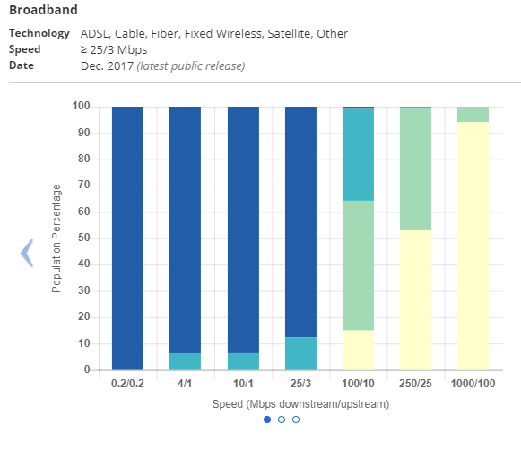
Maximum Advertised Speeds
Source: https://broadbandmap.fcc.gov/#/; Due to FCC data limitations, these data are designed as a descriptive and pragmatic tool and are not intended to be comprehensive.
Notes:
This slide depicts maximum advertised speeds for an area. Note that these are advertised speeds, not necessarily realized speeds. Thus, this data source may not provide as clear a picture of actual speeds as doing on-site speed tests. A number of apps are available to test local upload and download speeds.
Without adequate upload and download speeds, some applications will not function well or not at all.
Please note that these FCC data are limited and many have been critical of these data, but in the absence of other data we know that this is where communities go to measure their upload/download speeds.
Time: 5 minutes

Slide 9
Digital Divide Index: Purdue Center for Regional Development
Source: https://www.pcrd.purdue.edu/signature-programs/digital-divide-index.php
Notes:
Purdue Center for Regional Development at Purdue University has recently developed county level Digital Divide Index profiles. These provide several key points of data related to e-Connectivity. The index takes into account both the infrastructure availability as well as a number of socio-economic factors that tend to impact access, such as poverty and education.
According to their website:
“The Digital Divide Index or DDI ranges in value from 0 to 100, where 100 indicates the highest digital divide. It is composed of two scores, also ranging from 0 to 100: the infrastructure/adoption (INFA) score and the socioeconomic (SE) score.
The INFA score groups four variables related to broadband infrastructure and adoption: (1) percentage of total 2010 population without access to fixed broadband of at least 25 Mbps download and 3 Mbps upload; (2) number of residential broadband connections with at least 10 Mbps download and 1 Mbps upload; (3) average maximum advertised download speeds; and (4) average maximum advertised upload speeds.
The SE score groups four variables known to impact technology adoption: (1) percent population ages 65 and over; (2) percent population 25 and over with less than high school; (3) individual poverty rate; and (4) percent of noninstitutionalized civilian population with a disability. In other words, these variable indirectly measure adoption since they are potential predictors of lagging technology adoption.”
Time: 5 minutes

Slide 10
Telling Your Story
Using Data to Communicate Needs
Notes:
Have this slide up when participants enter.
The emphasis for this session will be on using publically accessible data to help define the local need, the first step in telling an effective story.
Time: 1 minute
Total session: 90 minutes

Slide 11
Types of Data to Help Tell Your Story
Population with Higher Education Degrees
Worker Productivity
Patents
Small Business Innovation Research Program Awards
Higher Education R&D Headcount and Expenditures
STEM Occupations
Employment with High Tech Industries
Innovation Index
Notes:
For this priority (insert the one discussed), we will be looking at these types of data. [Read from the slide for specifics related to this priority].
We will be looking at examples from one rural county in Kentucky just to provide a common context for the data.
Time: 1 minute

Slide 12
Percent of Population with Higher Education Degree
 | Total population 25 years old + | Number of individuals with Bachelor’s Degree (25 years +) | Number of individuals with Graduate Degree (25 years +) | Percentage of population with at least Bachelor’s degree (25 years +)
Bourbon County | 13,912 | 1,712 ± 273 | 926 ± 183 | 18.9%
Kentucky | 2,986,199 | 406,916 ± 4,801 | 285,652 ± 4,379 | 23.2%
Source: S1501 from American Community Survey
https://factfinder.census.gov/faces/tableservices/jsf/pages/productview.xhtml?src=bkmk
Notes:
This slide depicts the number and percentage of the population 25 years and older with a bachelor’s or graduate degree. We include the margins of error as part of the table because it’s important to know the quality of these data.
These data are important because there is a high correlation between education, productivity, innovation, and income. Rural communities tend to have lower educational rates and in many places, there is “brain drain,” where the highly educated leave the community for opportunities in more urban places.
Time:

Slide 13
Worker Productivity 2015
Goods producing includes:
Agriculture
Forestry
Mining
Construction
Manufacturing
Gross Domestic Product (GDP) output and number of personnel data available at: https://www.bea.gov/data/gdp/gdp-county
Notes:
This is a slide that measures worker productivity. This is important for e-connectivity because it is hypothesized that worker productivity is greatly hampered when there is limited or no access to the internet.
One measure of productivity or efficiency is the value of goods or services sold per worker. This is often measured as Gross Domestic Product (GDP) per worker and we can look at both the goods producing industries as well as productivity across all sectors. We expect worker productivity to be larger for goods producing sectors because of the capital intensive manufacturing process (fewer workers are needed when machines can do a lot of the work and advances in technology consistently improve worker productivity. Again if technology is limited because of lack of connectivity, GDP/worker will be lower.

Slide 14
Patents, 2015
1.3/1,000
jobs
Bourbon County
0.4/1,000
jobs
Kentucky
Source: https://www.uspto.gov/web/offices/ac/ido/oeip/taf/countyall/index.html
Notes:
Bourbon County is ranked 42nd out of 120 counties in the total number of patents. In 2015, approximately 1% of the total patents in Kentucky (664 patents) are in Bourbon County but less than 1% over the last 15 years.
Patents are the best indicators of innovation in a community, although still not a perfect measure. Patents measure innovation and technological change. One can look at the total number of patents, the ranking within the state, or the number of patents per job. This last measure controls for the size of the place. While Bourbon County only had 7 patents in 2015, overall the number of patents per job is higher than the state average.
Time:

Slide 15
Small Business Innovation Research Program Awards
Bourbon County, KY
2
Awards
1
Unique Applicant
Source: https://www.sbir.gov/sbirsearch/firm/all
Notes:
This slide depicts the total number of SBIR awards in the county. These numbers are typically pretty low in rural communities. SBIR awards are important indicators of innovation because a group of experts (review panel) has agreed that the proposed innovation has scientific merit AND potential for commercialization. States typically encourage and promote additional matching opportunities for the SBIR/STTR program. They see these awards as one way to create an entrepreneurial ecosystem.
Often individuals applying for SBIR/STTR awards are looking for partners, particularly university partners, for research and commercialization support.
Time:

Slide 16
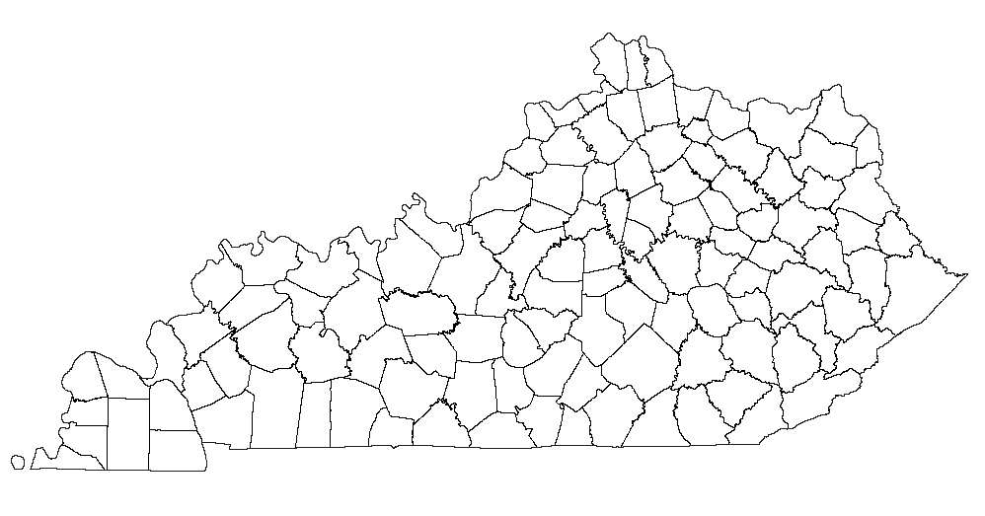
Higher Education R&D Personnel 2017
Northern Kentucky Univ.
159
Kentucky State Univ.
162
Bourbon County
Univ. of Louisville
2,657
Morehead State Univ.
10
Murray State Univ.
116
Univ. of Kentucky
6,042
Western Kentucky Univ.
396
Eastern Kentucky Univ.
94
Source: Higher Ed research and development survey https://ncsesdata.nsf.gov/herd/2017/
Notes:
This slide depicts: research and development dollars and personnel at public universities within the state of Kentucky. Research has suggested communities that are reside in a community with a university, or in close proximity to a university, tend to provide more economic opportunity for their residents in terms of jobs, higher wages, and more innovation.
Key things to consider are that in addition to public universities, private universities and colleges as well as 2-year community and technical colleges also can serve as important resources, particularly in rural communities.
Time:

Slide 17
STEM Occupations
Top 8 by Total Employment
SOC Code | Occupation Title | Total Employment | Location Quotient* | Median Annual Earnings
15-1121 | Computer Systems Analysts | 730 | 1.01 | $57,500
17-2112 | Industrial Engineers | 680 | 1.96 | $72,290
17-2051 | Civil Engineers | 450 | 1.19 | $86,720
19-2041 | Environmental Scientists & Specialists, Including Health | 390 | 3.89 | $47,510
17-3022 | Civil Engineering Technicians | 360 | 4.07 | $47,880
15-1151 | Computer User Support Specialists | 320 | 0.41 | $40,970
17-2141 | Mechanical Engineers | 310 | 0.84 | $81,410
Notes:
This slide depicts a sample of STEM occupations, the location quotient, and median earnings. The handout provides all of the occupations that are considered “STEM.” The Location Quotient measures the relative concentration of that occupation compared to the national average. An LQ >1 suggests a relative concentration.
This is important because STEM occupations tend to earn higher than average earnings. These occupations are also correlated with high-tech and innovative sectors.
Key things to consider are: Lately STEM has been expanded to STEAM where the A stands for either “agriculture” or “arts,” depending on the program.
Time:

Slide 18
Employment within High-Tech Industries
NAICS | Industry Description | Establishments | Employees | Average annual pay
325 | Chemical Manufacturing | 1 | ND | ND
333 | Ag, Construction and Machine Manufacturing | 4 | 95 | $70,201
336 | Motor Vehicle Manufacturing | 3 | 601 | $64,806
511 | Newspaper, Periodical, Book, and Directory Publishers | 2 | ND | ND
517 | Wired and Wireless Telecommunications Carriers | 2 | ND | ND
518 | Data Processing, Hosting, and Related Services | 1 | ND | ND
5415 | Computer Systems Design and Related Services | 9 | 10 | $80,925
5416 | Management, Scientific, and Technical Consulting Services | 5 | 6 | $72,106
5417 | Scientific Research and Development Services | 1 | ND | ND
Source: Bureau of Labor Statistics; website: https://data.bls.gov/PDQWeb/en
Notes:
* High-tech industries include the following NAICS codes: 21, 325, 3332, 3333, 3336, 3339, 3341, 3342 3343, 3344, 3345, 3346, 3353, 3364, 5112, 5173, 5174, 5182, 5191, 5413, 5415, 5416, and 5417.
Based on Wolf and Terrell, “The high-tech industry, what is it and why it matters to our economic future,” Beyond the Numbers, Bureau of Labor Statistics, 2016, 5(8).
This slide depicts employment by high-tech industry. There are approximately 20 industries (defined by NAICS) code that are considered high-tech. Many rural places might only show employment in a few of those sectors.
What are the ND’s? This slide highlights the challenges associated with publicly available data in rural places. Often, if there are only 1-2 establishments then the Bureau of Labor Statistics will not provide data related to employees or wages. This is exactly why many Universities and economic development professionals rely on proprietary data to help understand conditions in rural communities.
This is important because high-tech industries tend to pay higher than average earnings and these industries are often clustered together resulting in continuous innovation and efficiencies.
Key things to consider are that many rural communities have lost employment in the high-tech goods producing industries like mining and manufacturing and as a result have lost high-quality jobs. Is it possible to identify other sectors that are not as capital intensive that might benefit rural communities?
* High-tech industries include the following NAICS codes:
21 - Mining, Quarrying, and Oil and Gas Extraction
325 – Chemical Manufacturing
3332 – Industrial Machinery Manufacturing
3333 – Commercial/Service Industry Machinery Manufacturing
3336 - Engine, Turbine, and Power Transmission Equipment Manufacturing
3339 - Other General Purpose Machinery Manufacturing
3341 - Computer and Peripheral Equipment Manufacturing
3342 - Communications Equipment Manufacturing
3343 - Audio and Video Equipment Manufacturing
3344 - Semiconductor and Other Electronic Component Manufacturing
3345 - Navigational, Measuring, Electromedical, and Control Instruments Manufacturing
3346 - Manufacturing and Reproducing Magnetic and Optical Media
3353 - Electrical Equipment Manufacturing
3364 - Aerospace Product and Parts Manufacturing
5112 - Software Publishers
5173 - Wired and Wireless Telecommunications Carriers
5174 - Satellite Telecommunications
5182 - Data Processing, Hosting, and Related Services
5191 - Other Information Services
5413 - Architectural, Engineering, and Related Services
5415 - Computer Systems Design and Related Services
5416 - Management, Scientific, and Technical Consulting Services
5417 - Scientific Research and Development Services
Time:

Slide 19
Innovation Index
Source: http://www.statsamerica.org/ii2/
Notes:
The index is based on five major categories including: Human Capital and Knowledge Creation index, Business Dynamics Index, Business Profile index, Employment and Productivity index, and Economic Well-being index.
Website: http://www.statsamerica.org/ii2/
This slide depicts an overall innovation ranking for each county in the country. This ranking is based on five different indices that compromise a number of indicators.
This is important because this is the only database that effectively measures innovation and standardizes across the nation.
Key things to consider are these data are a bit outdated and it’s not certain when or if the data will be updated for version 3.0.
Time:

Slide 20
Telling Your Story
Notes:
This slide serves as a transition to the next section.
Data is an essential part of telling your story as you often begin by describing a need that you want to address.
We will spend the next few minutes exploring how to turn data into this part of the story, and will end with a friendly competition.
Time: 1 minute

Slide 21
Elements of a Strong Story
State the need clearly
Use data to back up the need
Give an example of someone affected
Provide a clear statement of what you plan to do about the need
Notes:
Writing a strong story such as for a grant proposal or partnership invitation includes several key components such as:
A clear statement of the need you are hoping to address
Use of relevant data to help support your need statement
An example of someone that is affected by the need
What you plan to do about the need
We will be exploring the last bullet in a later session. For the next few minutes, we will focus on the first three.
Distribute handout: Telling My Story – Writing a Need Statement
For the next few minutes, imagine that you are a part of the community in our data example. Think about how you would use these data to describe the local need around this priority. Use the handout to draft your story.
Your goal is to get the statement down to something you can share in 1 minute or less.
Time: 15 minutes

Slide 22
I Like Your Story
Notes:
For the next few minutes, we’re going to have a quick and fun friendly competition.
Divide the participants into small groups of 4-6. Assign a timekeeper for each table. Each person in the small group has one minute to share their story. After all have finished, participants give their baseball to the person that made the best needs “pitch.”
Then those winners from each group will have 1 minute to tell their story to the whole group, and the group will select the winner by show of hands to present to the larger group.
If time is short, you can adjust this by changing the size of the small groups OR asking for a few volunteers to share with the whole group in order to select a winner from the room. The winner will share their needs statement with the larger group over lunch.
Time: 15 minutes

Slide 23
Questions and Discussion
Notes:
Wrap up with any final questions or thoughts as time allows.

